Slide 1
The 2025 Empowering Health & Technology Webinar Series
Navigating the Future of AI Regulation
May 16, 2025
University programs, activities, and facilities are available to all without regard to race, color, sex, gender identity or expression, sexual orientation, marital status, age, national origin, political affiliation, physical or mental disability, religion, protected veteran status, genetic information, personal appearance, or any other legally protected class.

Slide 2
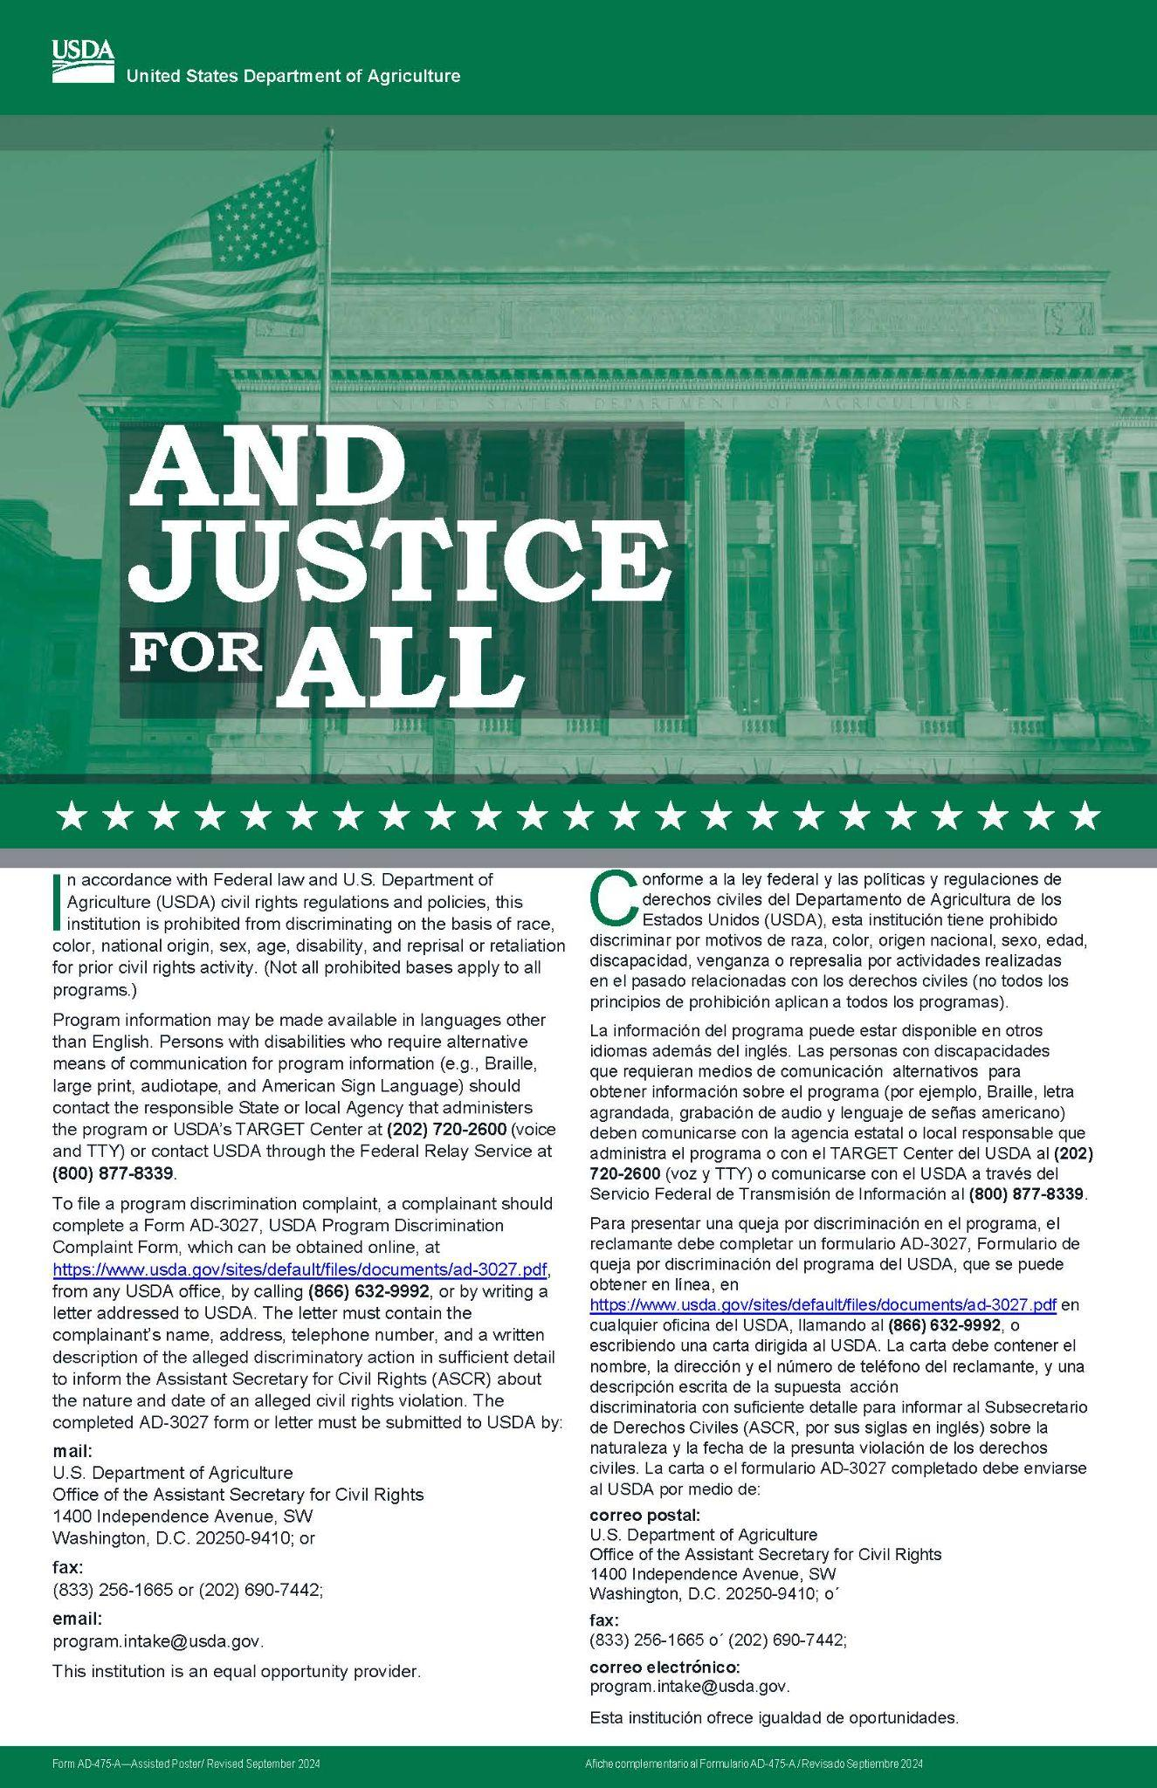
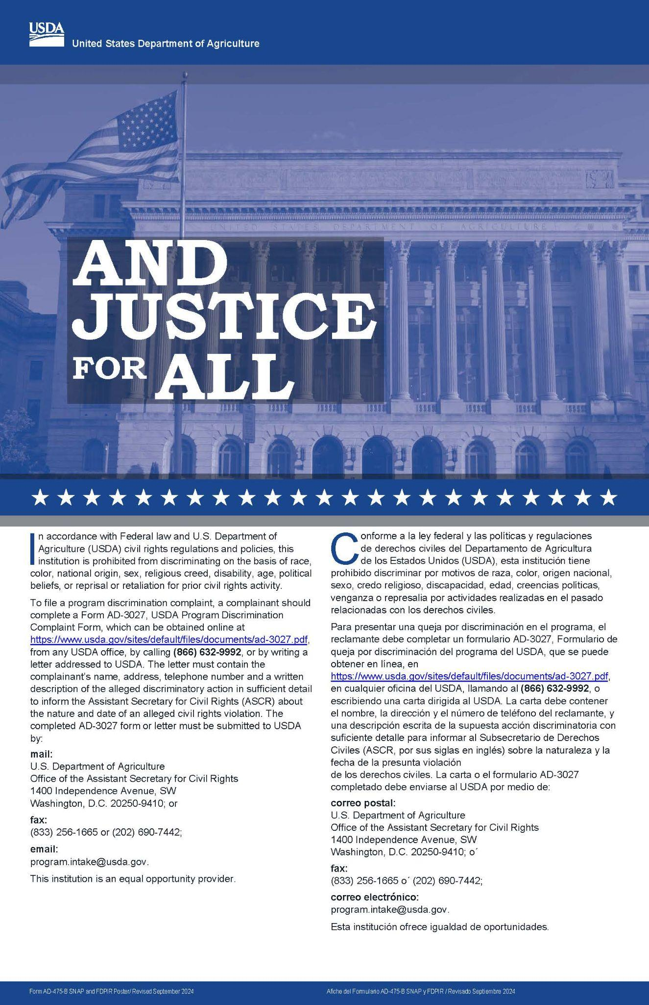
University programs, activities, and facilities are available to all without regard to race, color, sex, gender identity or expression, sexual orientation, marital status, age, national origin, political affiliation, physical or mental disability, religion, protected veteran status, genetic information, personal appearance, or any other legally protected class.

Slide 3
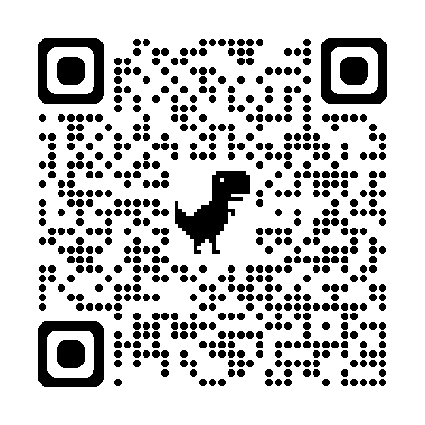
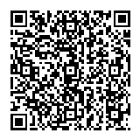
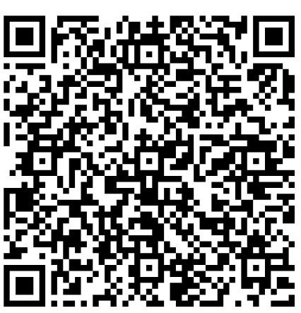
Scan the QR Codes to
Complete the Conference Survey
Register for the
Webinar Series
Meet the Speakers

Slide 4
Exploring AI Policy Landscape and Its Implications
Scan for Bios

Slide 5
Continue learning about
the future of health and technology! Join us for
the Empowering Health
Webinar Series
May 16th - June 27th.
Scan QR to
Register or visit
https://go.umd.edu/HealthWebinarRegister
Notes:
https://go.umd.edu/HealthWebinarRegister

Slide 6
Get in Touch
www.MarylandersOnline.umd.edu
MarylandersOnline@umd.edu
Toll-Free Tech Helpline: 1-866-206-8467
Monday to Friday: 10 a.m. to 8 p.m. Saturday: 10 a.m. to 5 p.m.

Slide 7
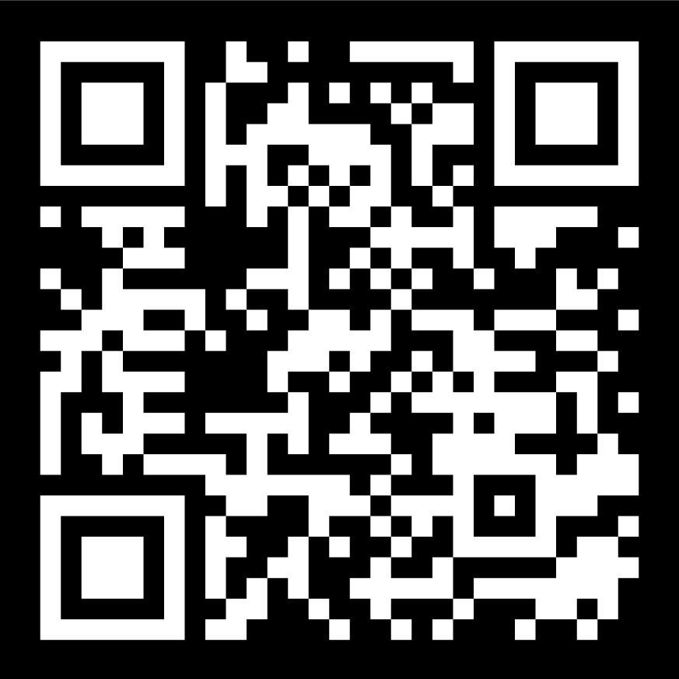
Stay Connected with
Marylanders Online
Marylanders Online
@MarylandersOnline
Marylanders Online
Linktree
Newsletter Signup

Slide 8
Thank you for
Attending the
2025 Empowering Health Webinar Series!
Please provide feedback by completing our brief survey.

